Slide 1
FISH 521 Peer review

Slide 2
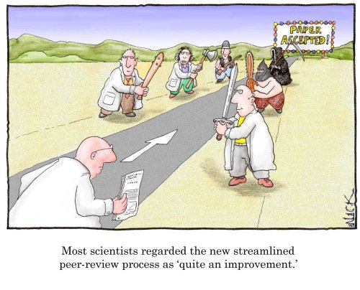
Peer review
Mechanics
Advantages
Challenges
Solutions

Slide 3
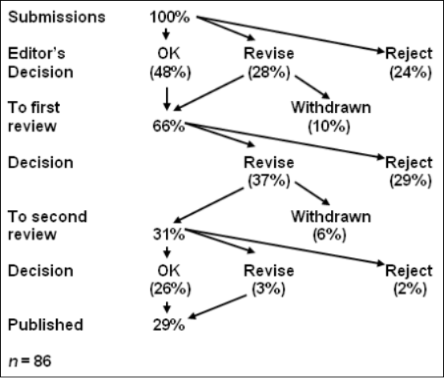
Peer Review Process

Slide 4
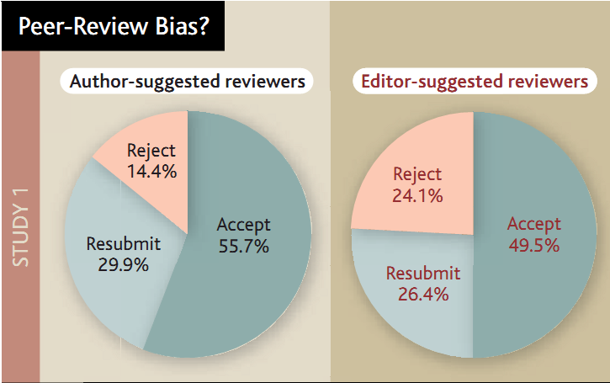
Peer Review
Who is a peer?
Your mates
Yourself
What is a review?
Formal vs informal
What can be expected from a reviewer?

Slide 5
Peer review – what is it for?
Proposal
Manuscript
Objective
Fund best proposals
Audience
Reviewer
Science Panel
Program Manager
Outcome
Yay or nay
Suggestions for resubmission
Objective
Prevent publication of bad science
Improve manuscripts
Audience
Reviewer
Editor
Reader
Outcome
Yay or nay
With qualifications
Improvements

Slide 6
What is the purpose of peer review?
Select novel and important proposals / findings
Detect errors and fraud
Improve manuscripts / proposals

Slide 7
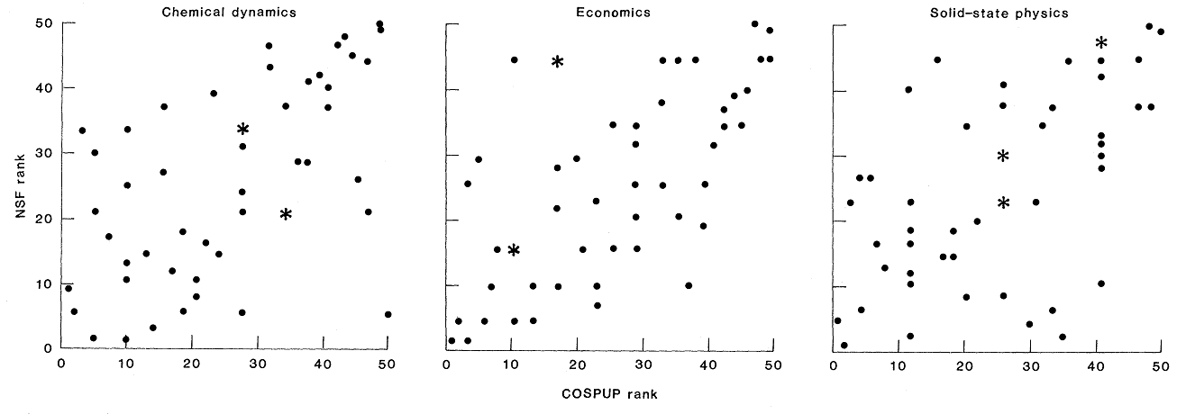
What is the purpose of peer review?
Select novel and important proposals / findings
Reviewers often disagree
NSF: (Cole et al 1981)
reversal rate 25%
Proposal succes: 50% quality of proposal, 50% luck

Slide 8
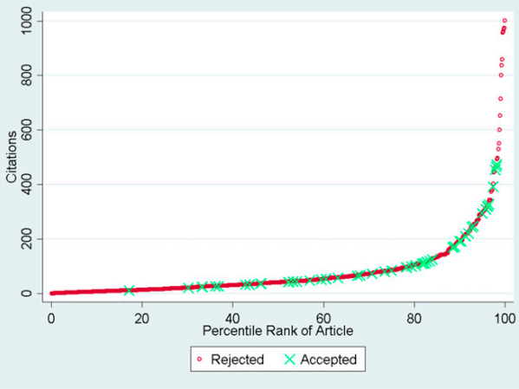
What is the purpose of peer review?
Select novel and important proposals / findings
Not always correlated with ultimate success
Siler et al. 2015, PNAS

Slide 9
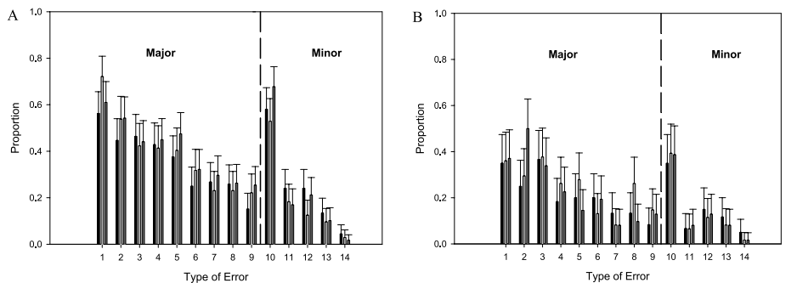
What is the purpose of peer review?
Select novel and important proposals / findings
Detect errors and fraud
Not very effective
Double publication - MPU
Schroter et al 2008

Slide 10
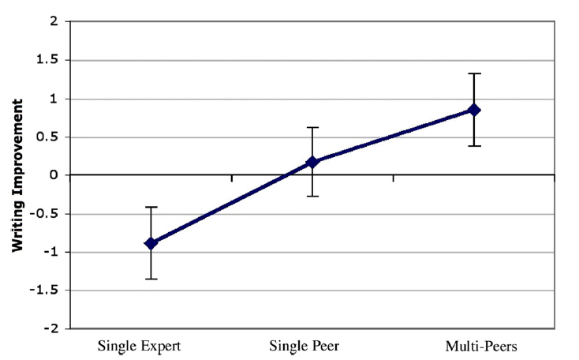
What is the purpose of peer review?
Goodman et al 94
Select novel and important proposals / findings
Detect errors and fraud
Improve manuscripts
Tables & Figures – not much improvement
Not much commented on
Schriger et al 2006
Text: considerable improvement
Goodman et al 94
Personal experience

Slide 11
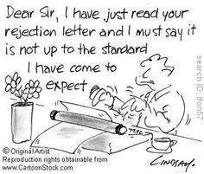
What are the problems of peer review?
Inefficient
Slow
Expensive
Inconsistent
Reviewer overload
Cascading peer review
Bias
Author, institution
Country of origin
Gender
Seniority
Abuse
Plagiarism & Scooping
False reviewers

Slide 12
Improvements of peer review
Open vs blind vs double blind
Double blind may be better
Many reviewers guess authors
Training reviewers
Apparently little effect
Published reviews
PeerJ
Online comments

Slide 13
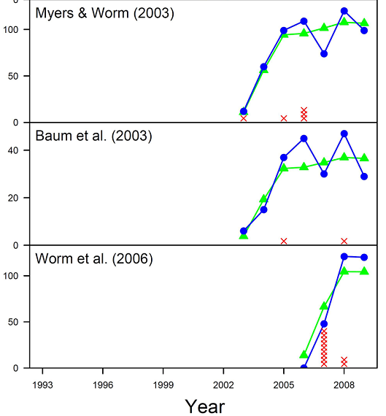
Alternatives to peer review
Publish reviews
Real time
Blog-type publishing
Can leave comments
Most uninformative
Rebuttals and withdrawals
Banobi et al 11

Slide 14
There may be nothing better Do you agree or disagree?
Without peer review there is no control in scientific communication
Peer review is unsustainable because there are too few willing reviewers
Scientific communication is greatly helped by peer review of published journal papers
Peer review is a concept well understood by the scientific community
The current peer review system is the best we can achieve
Plagiarized from
http://www.stm-assoc.org/2011_10_11_Frankfurt_Conference_Mulligan_Peer_Review.pdf

Slide 15
What is most effective?
Single-blind peer review
Double-blind peer review
Open peer review
Open & published peer review*
Supplementing review with post-publication review
Peer review could in principle be replaced by usage statistics
Plagiarized from
http://www.stm-assoc.org/2011_10_11_Frankfurt_Conference_Mulligan_Peer_Review.pdf

Slide 16
Reviewing
When you get the request, consider
Do I have time?
A review takes at least 5-6 hours, sometimes more
Am I qualified?
If you are not qualified,
If you are one of the few people qualified, you should probably do it
If you decline suggest alternative reviewers
If accepted, consider
Confidentiality
Do not discuss, unless cleared by editor / program manager
Do no use for your own research
Aims of journal / RFP
General / specific readership

Slide 17
Why peer review?
Giving back – it’s part of the system
Your papers get reviewed, so you need to review
Should review 2 papers for every published paper
Learning
You get manuscripts before publishing
You learn about the peer review process
Many journals copy decision letters to reviewers
You learn even from bad manuscripts
E.g. how not to do it
Reputation
Editors may be your reviewers/editors

Slide 20
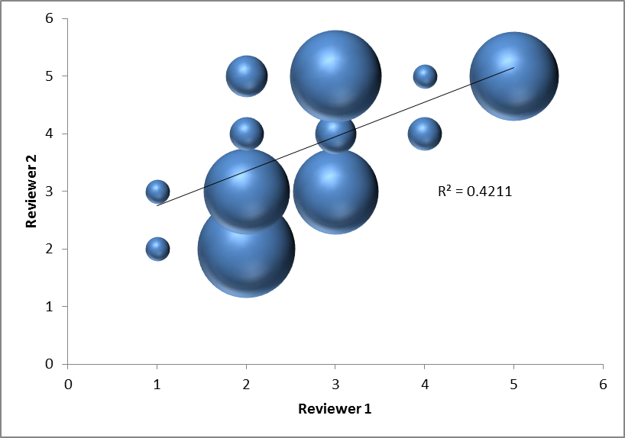
Agreement between reviewers
Journal of Fish Biology
1998-2004
Accept
Minor
Major
Redirect
Reject
NSF: (Cole et al 1981)
reversal rate 25%
Proposal succes: 50% quality of proposal, 50% luck

Slide 21
Questions about peer review
The peer review process
consequences?
Who is a peer?
What is a peer review?
What is it for?
Proposals vs manuscripts
Quality
Improvements
Fraud and errors
What are the issues?
Reliability
Time and expense
Bias
Effectiveness
Predictive validity
Improvements
Blind vs double blind
Reader approach
Alternatives
Online blog
Conclusions

Slide 22
General points
Why should you review?
How to comment?
How to review?
Manuscripts
Proposal
Process
Getting the invitation
Deciding whether to accept
Reviewing
Commenting
Submitting the report

Slide 23
General Review Guidelines
Reviews are confidential
Do not discuss with peers
Involve others only after checking with editor or program manager
Inform editors / program managers of conflicts of interest
Be constructive
Don’t be sarcastic
Manuscripts: Suggest improvements
Shortening
More information
Start with general comments
Brief description of content
Main strengths
Main weaknesses
Objectives
Is the problem relevant?
Does it correspond to the RFP?
Do objectives / hypotheses address the problem?
Rationale and Scope
Is the scientific rationale sound?
Methods
Are the methods adequate?
Are facilities and expertise available?
Are statistical analyses appropriate?
Do analyses allow an interpretation addressing the problem?
Is the scope of work realistic?
Budget
Are requests appropriate?
Are they sufficiently justified?
Biography
Does the PI have the expertise?
Past track record of applicants

Slide 24
Issues with peer review
Anonymity
Reviewers anonymous or not
Publish reviews
Double blind reviews
Bias
Gender, nationality, rank, status etc
Conflict of interest
Competitors and friends
Double blind reviews
Effectiveness
Lack of expertise of reviewers
Who is a peer?
Reviewers don’t find all flaws
Intrinsically conservative
Reviewers don’t agree
Expensive
Opportunity costs

Slide 25
How to write a review
Manuscripts
General comments
Major flaws / problems / issues
Specific comments
Specific wording, grammar style
Figures and tables
Proposals
Usually fairly specific
RFP

